Slide 1
Chapter 8
Web Analytics
J.P. Allen version 4-15-19

Slide 2
Highlights and Key Takeaways
Digital businesses use web analytics to learn more about how potential customers are using a web site.
Web analytics provides data on all three phases of the ABC process: how many potential customers are acquired through each online channel; how visitors behave on a prototype; and the conversion actions taken by visitors that reflect business success.
Web analytics also relates these phases to each other by, for example, showing which online channels result in the most successful conversions.
Web analytics tracks visitor actions through information that is collected every time a web page loads in a browser, and by collecting information about specific on-page actions.
Web analytics reporting and measurement depend on assumptions that may or may not be appropriate for a particular digital business.
By the end of the chapter, the reader should be able to install web analytics tracking on a prototype, and test that web analytics is working properly.

Slide 3
What is Web Analytics?
Web analytics is a technology that measures the performance of web sites, including digital business prototypes.
Web analytics provides data on all three steps of the ABC process, including how many visitors have been acquired, user behavior, and the actions taken by customers that lead to business results.
Web analytics provides the data to answer important business questions, such as:
How many visitors came to our site?
How did they get here? Did they search for us, click on an advertisement, or follow a link from another site?
Which pages are the most popular?
How many visitors watched an introductory video?
How often did visitors look at the help pages?

Slide 4
Tracking Code and Cookies
Web analytics collects data on visitors by adding tracking code to each web page, and by saving small history files called cookies in a visitor’s web browser.
The tracking code sends a message to the analytics service every time a web page is loaded into a browser.

Slide 5
Sample Tracking Code: Google Analytics
<!-- Google Analytics --> <script> (function(i,s,o,g,r,a,m){i['GoogleAnalyticsObject']=r;i[r]=i[r]||function(){ (i[r].q=i[r].q||[]).push(arguments)},i[r].l=1*new Date();a=s.createElement(o), m=s.getElementsByTagName(o)[0];a.async=1;a.src=g;m.parentNode.insertBefore(a,m) })(window,document,'script','https://www.google-analytics.com/analytics.js','ga'); ga('create', 'UA-XXXXX-Y', 'auto'); ga('send', 'pageview'); </script> <!-- End Google Analytics -->
This code is placed in the <head> part of every html document to be tracked.
Where UA-XXXXX-Y is replaced with your Google Analytics property ID.
google.com

Slide 6
Pageviews
The tracking code records an interaction called a pageview in Google Analytics, and it includes:
The URL and title of the page being viewed.
The IP address of the client that asked for the page, and the domain name previously visited.
The technology being used to view the page (screen size, device, platform, etc.).
Time and date.
Data stored in a cookie about previous visits, if a cookie exists.

Slide 7
Pageviews Provide Data on Customer Interactions
The URLs and titles tell us which pages are visited the most, and in what sequence.
IP addresses and previously visited domain names tell us where a visitor is located (within certain limits) and which sites are the sources of potential customers.
The technology information can tell us if the site is more or less popular with certain platforms (for example, Android vs. Apple) or devices (laptops vs. phones).
The time and date of a series of pageviews can tell us how long a visitor stays on site, and which content visitors spend more time on.
Data stored in cookies can tell us whether a visitor is new to our site, or if they are a returning visitor.

Slide 8
Event Tracking Code
Not every customer interaction of interest is a pageview.
Additional pieces of tracking code can be added to other HTML tags on your site. This code sends messages about additional interactions, called events in Google Analytics.
Events are other interactions on a web site that don’t involve loading a new web page into a browser or app.

Slide 9
Event Examples
Examples of important events to track might include:
Clicking on a link to another site, or an outbound link.
Downloading a document.
Clicking on an email link.
Clicking on a button to submit a form.
Playing a video.
Starting a live chat.
Scrolling to, or hovering over, a part of the screen.

Slide 10
Sample Event Tracking Code
For example, to add event tracking code to an outbound link like this:
<a href=”www.jpedia.org”>Link to an external site.</a>
the additional event tracking code might look something like this:
<a href=”www.jpedia.org” onclick="ga('send', 'event', 'CATEGORY', 'ACTION', 'LABEL');">Link to an external site.</a>
where ‘CATEGORY’, ‘ACTION’, and ‘LABEL’ are filled in with labels of your own choice for tracking purposes.

Slide 11
Analytics and Privacy
A web browser must have Javascript and cookies enabled for tracking to work properly.
European Union GDPR regulations require a positive opt-in from consumers for cookies.
Some browsers are choosing to block web analytics tracking either by default, or with the use of browser add-ons.

Slide 12
Discussion Question
Discuss whether any of the assumptions Google Analytics makes about your users and their technology will be of concern for your prototype.
For example, will your users trust you enough to accept cookies? Will you be tracking the right events?

Slide 13
Web Analytics Measures
Google Analytics captures the raw data from the two kinds of user interactions, pageviews and events, and creates a number of useful measures of web site performance, including:
Sessions – a session, sometimes called a visit, is a series of interactions within a certain time period.
By default, interactions tracked by Google Analytics within a 30 minute time period are counted as one session, but the maximum length of a session can be changed.
A series of pageviews and events longer than 30 minutes will count as more than one session.
Users, New and Returning – Google Analytics creates a unique user ID for every visit, which identifies a sequences of pageviews and events as coming from a single user.
If a browser allows GA cookies to be stored, the same user ID can be used in the next session, and the visitor can be recognized as a returning user rather than a new user.

Slide 14
Web Analytics Measures (2)
Active Users – the number of users currently interacting with a site.
Active users are visible in the ‘Real Time’ reports in Google Analytics, while most other data is delayed by up to 24 hours.
Bounce Rate – a session that has no interactions after the first pageview is called a bounce. The bounce rate is the percentage of all sessions that are bounces.
Because a bounce, where a user arrives at a site and immediately leaves, is considered a failure for many digital businesses, bounce rate is one of the most immediate measures of site performance.
Session Duration – the length of time between the first and last interaction in a session.
Longer session durations might be considered a positive in a content-based business, suggesting that visitors find the content more engaging. In a more transaction oriented business, however, longer times might reflect confusion about how to navigate a site.

Slide 15
Web Analytics Measures (3)
Traffic Medium, Source, and Channel – each session is assigned a medium and a source to describe where a user came from.
The medium is the most generic description of traffic sources.
Possible medium values include referrals (the visitor followed a link from another web site); organic (the visitor came from the unpaid or ‘organic’ results of a search); paidsearch (the visitor came from advertisements on search results); or none (the visitor came some other way, including typing a domain name directly into a browser).
The source is the name of the specific site, if any, that a visit came from.
Common combinations of medium and source are grouped into channels, which provide a generic set of traffic sources that is more specific than a medium.

Slide 16
Web Analytics Measures (4)
Entrances and Exits – the first and last pages visited in a session.
Exit pages are sometimes used to determine which parts of a site are more likely to drive visitors away.
Location – by recording the IP addresses of visitors, Google Analytics can guess where a visitor is located, by city and country.
IP addresses are usually unique to Internet Service Providers, rather than individuals, so location information is often useful enough, but not perfect.
Device – Google Analytics receives information about the browser being used, which language it is set to, which platform or operating system is running on a device, and the current size of the screen.
With this information, GA can usually determine, for example, which visitors are using an Android phone, versus a Windows laptop.

Slide 17
Web Analytics Measures (5)
Demographics and Interests – beyond the IP address, and the history of interactions on your site, Google Analytics has little information about a visitor. The larger Google advertising network, and other major ad networks, often have much more information about a person.
This information, available for visitors to a site who are logged into Google, can be accessed in analytics by turning on the Demographics and Interests option in GA.
Goals and Conversions – any interaction, including pageviews and events, can be defined as a goal. A goal represents a session that has a successful business outcome, whether it be buying something, contacting a business, or clicking on an advertisement.
A conversion is recorded when a visitor successfully reaches a goal.

Slide 18
Web Analytics Reports: Audience
Audience – reporting about numbers of visitors, how often they return, where they come from, and what technology they use.
If an GA account is linked to a Google advertising account, information is available about visitor age, gender, and interests.
These reports can be used to, for example, identify new countries or areas that are unexpectedly interested in a digital business, and tailor more content, products, or services for those regions.
Audience reports can also reveal how often users return to a business, and how many visits it takes a typical visitor to convert.

Slide 19
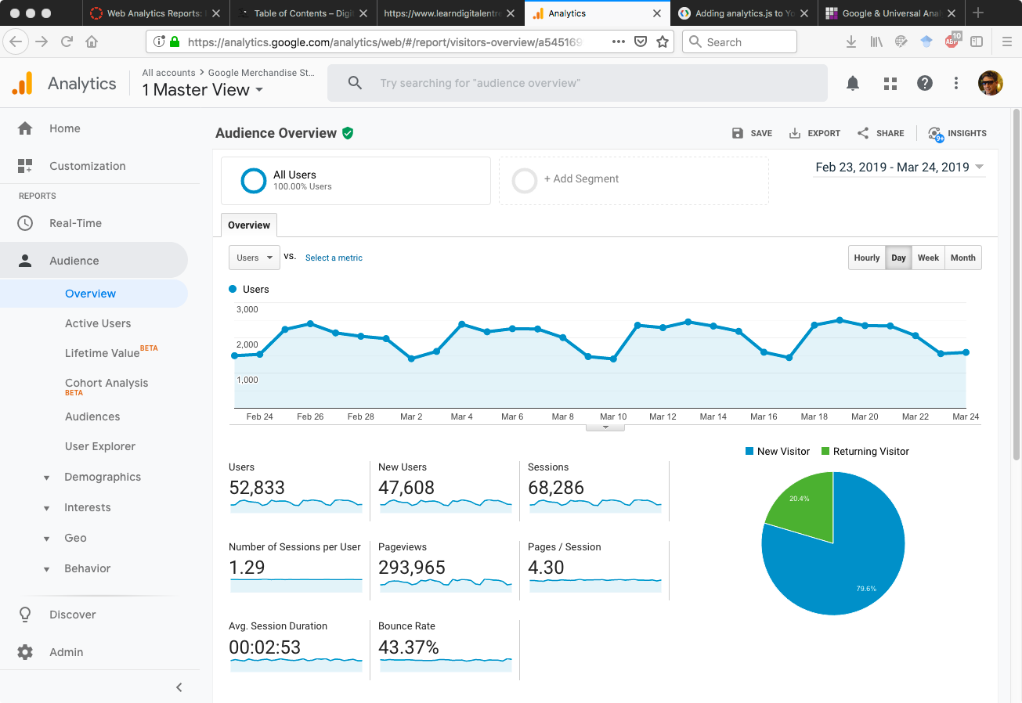

Slide 20
Web Analytics Reports: Acquisition
Acquisition – reporting about the medium, source, and channels sending visitors to a site.
By integrating Google Analytics with other services, more detailed acquisition information is available. For example, by combining GA with a Google Ads account, the analytics reports will contain detailed information about which advertisements and keywords were more successful for customer acquisition.
By linking up with a Google Search Console account, the analytics reports will include the exact search phrases that visitors use to find your business.
Customer acquisition reporting can be made even more precise by defining campaigns.
A campaign is a specific set of marketing activities intended to generate new customer leads, such as an advertising campaign or a series of local events. Each campaign can be given a unique URL for clicking to a prototype site, by adding additional parameters at the end of the URL.

Slide 21
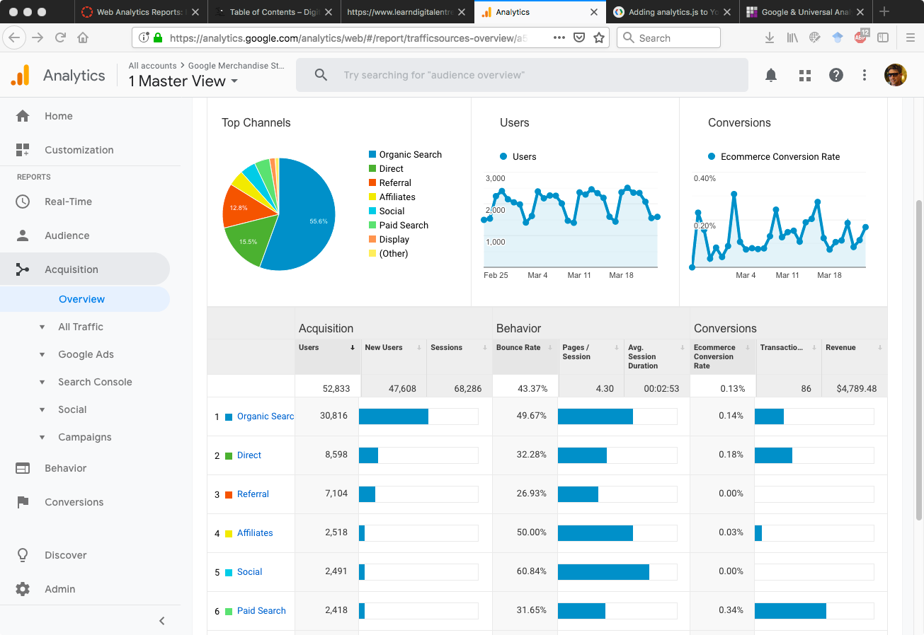

Slide 22
Web Analytics Reports: Behavior
Behavior – reporting about how often pageviews and events are recorded, and in what sequence.
Behavior reports show the most popular content, information which can be used to adjust how articles, product descriptions, and blog posts are written in the future.
Behavior flow reports can be used to look for unexpected paths that customers take through a site.
Behavior reports also report on page loading times, which can be used to identify slow pages that might be frustrating potential customers.
Behavior reports can also be linked to other Google services.
By linking to a Google AdSense account, digital entrepreneurs can see which content on their site is generating more advertising revenue.
Behavior reporting can show the results of experiments created in Google Optimize, where different versions of a page are randomly assigned to visitors to see which version performs better.

Slide 23
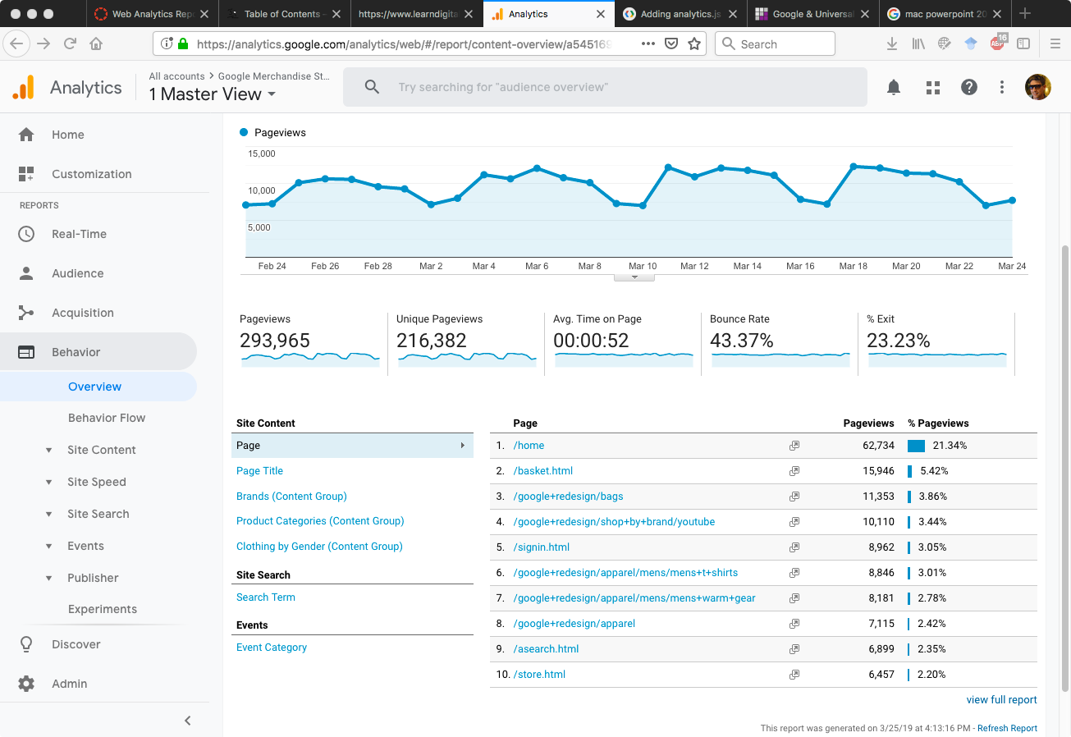

Slide 24
Web Analytics Reports: Conversions
Conversions – A conversion is tracked either through a pageview or an event, that is defined as a goal in Google Analytics.
Because conversions reflect business success, tracing back successful conversions to behavior (which pages were visited) and acquisitions (where visitors came from) is where the power of web analytics truly lies.
A consistent path to conversion by visiting a sequence of pages is called a funnel.
For example, a shopping funnel could include a sequence of web pages for putting a product in a cart, entering shipping information, and then entering payment information.
Conversion reports can show if specific steps in the funnel are losing customers.

Slide 25
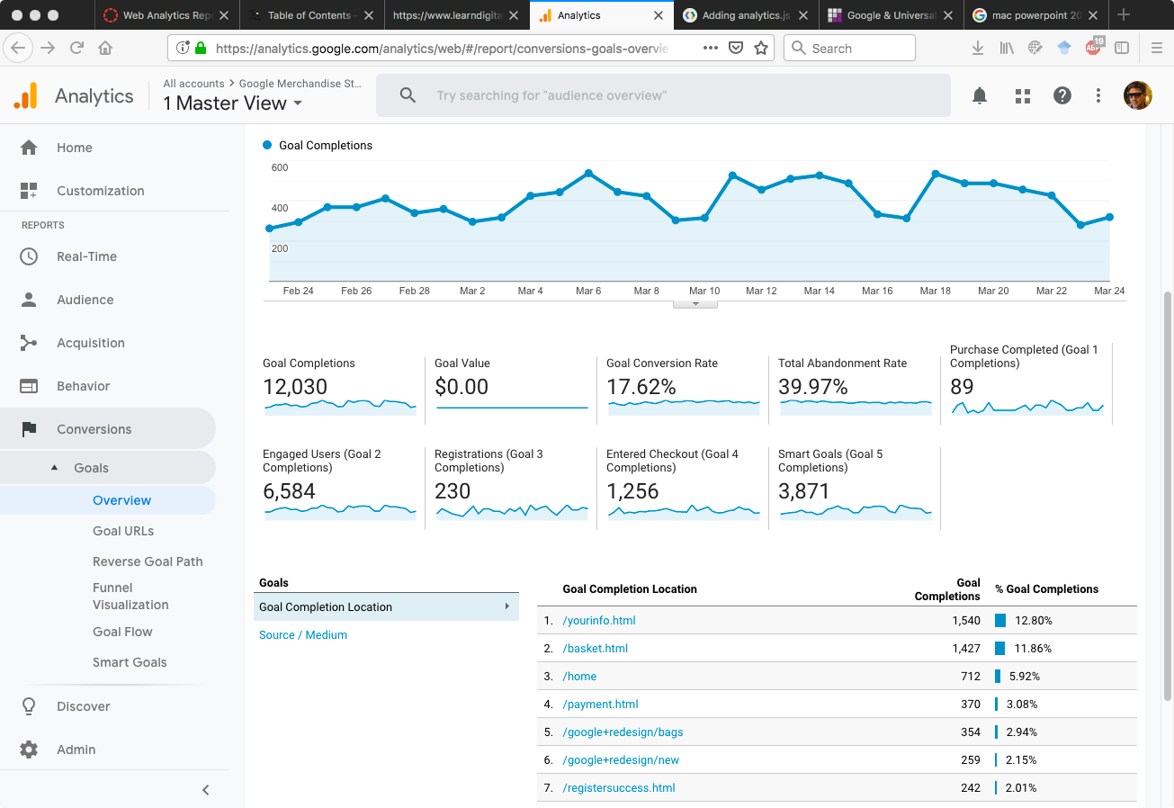

Slide 26
Segments and Dimensions
Conversion reports can also use customer segmentation to improve performance reporting. Segments can be used to divide visitors into distinct groups with different objectives.
For example, one group of visitors might be searching for information about a product, versus another group that is ready to buy.
Web site performance can be measured differently for each subgroup.
For all reports, measures can be related to each other by adding new dimensions that cut across customer acquisition, behavior, and conversions data.
One popular example is to add the source of customer acquisition as a dimension to a conversions report, answering the question of which visitors are more likely to lead to business success.

Slide 27
Discussion Question
List three important questions that web analytics can answer about your digital business prototype. Mention any specific measures that are most relevant.

Slide 28
Setting Up Google Analytics
Visit https://marketingplatform.google.com/about/analytics/
Log in with Google ID
Enter account name
Enter URL of website to track

Slide 29
Exercise
Create a Google Analytics account.
Find the tracking ID for the Google Analytics property that will be used to track your digital business prototype.

Slide 30
Accounts, Properties, Views
Each Google Analytics account can have up to 50 properties.
Each property corresponds to a different web site, located at its own URL.
Enter a name and the URL of the prototype site to be tracked by Google Analytics. Click on the ‘Get Tracking ID’ button at the bottom. This will create a unique tracking ID for your site, and make available the tracking code for your site.
Each property in GA has at least one view.
All new properties start with one view, called ‘All Web Site Data’.
Additional views can be created to share subsets of web site data with specific users.
Users can be added to an entire GA account, a specific web site property, or only to a specific view by selecting ‘User Management’ from the ‘ADMIN’ menu of the Google Analytics account, and adding a new user’s email addresses.

Slide 31
Connecting a Prototype via Plugins
WordPress plugins are available that will automatically add the correct Google Analytics tracking code to each page on your site.
To do this, install the plugin ‘Google Analytics Dashboard for WP’ on your WordPress site, and activate.
A new menu called ‘Google Analytics’ will appear on the left of the WordPress administrator area.
Select this menu and click on the ‘Authorize Plugin’ button. Follow the instructions to obtain an access code from Google.
Select a view that includes your site URL, then ‘Save Changes’ at the bottom of the screen.

Slide 32
Testing the Analytics Connection
To confirm that Google Analytics is successfully tracking interactions on your site, return to your Google Analytics account and select ‘REAL-TIME’ from the reports menu on the left side of the screen, then ‘Overview’.
Load a page from your site into another tab on a web browser. If GA shows an active user on your site, congratulations, Google Analytics is working!
Real Time reports should show results immediately, but it can take up to 24 hours for data to appear in the other standard reports.

Slide 33
Exercise
Connect Google Analytics to your prototype site.
Using real time reports, show that the connection is working.

Slide 34
Turning On Event Tracking
When first installed, the Google Analytics plugin is only tracking pageviews, but not events.
To turn on event tracking, go to the ‘Google Analytics’ menu in your WordPress administrative area, select ‘Tracking Code’, then the ‘Events Tracking’ tab.
Turn on any events you wish to track, such as downloads and outbound links, and click ‘Save Changes’ at the bottom.
You can confirm that events are being tracked by adding an outbound link on your prototype site, clicking on the outbound link, then looking at the ‘REAL-TIME’ ‘Events’ report in Google Analytics.

Slide 35
Exercise
Create a new view of your prototype’s property in Google Analytics, and give another user access to that view.

Slide 36
Stop Tracking Yourself
Once the Google Analytics is proven to be working, it’s common practice to stop tracking your own visits to your site.
By selecting the ‘Exclude Tracking’ tab in the Google Analytics plugin setting, then clicking on the ‘Administrator’ check box and saving, the plugin will ignore your own visits and track only your potential customers instead.

Slide 37
Additional Links
www.w3schools.com/js/js_events_examples.asp—examples of other Javascript events that can trigger a Google Analytics event.
adssettings.google.com/—see the information that Google advertising networks have about yourself.
ads.google.com—Google Ads, one of the most popular services for designing and purchasing advertisements that will appear on other sites and appear on Google search results.
search.google.com/search-console—service for monitoring the use and health of websites, particularly useful for tracking the search terms that visitors enter to find a site.
ga-dev-tools.appspot.com/campaign-url-builder/—tool for creating URLs that add Google Analytics campaign information to a link.

Slide 38
Additional Links (2)
www.google.com/adsense—Google AdSense, one of the largest services for publishing advertisements on a site.
marketingplatform.google.com/about/optimize/—Google Optimize, a service for performing content experiments.
marketingplatform.google.com/about/analytics/—sign up for Google Analytics here.
wordpress.org/plugins/google-analytics-dashboard-for-wp/—popular WordPress plugin for Google Analytics.
analytics.google.com/analytics/academy/—help and tutorial information about Google Analytics.
www.lunametrics.com/about-us/case-studies/—collection of Google Analytics-oriented success stories.

Slide 39
Supplemental materials for the book:
Digital Entrepreneurship,1st Edition
by Jonathan P. Allen
Published by Routledge, 2019.
Routledge website
Book website with additional materials and ideas

