Slide 1
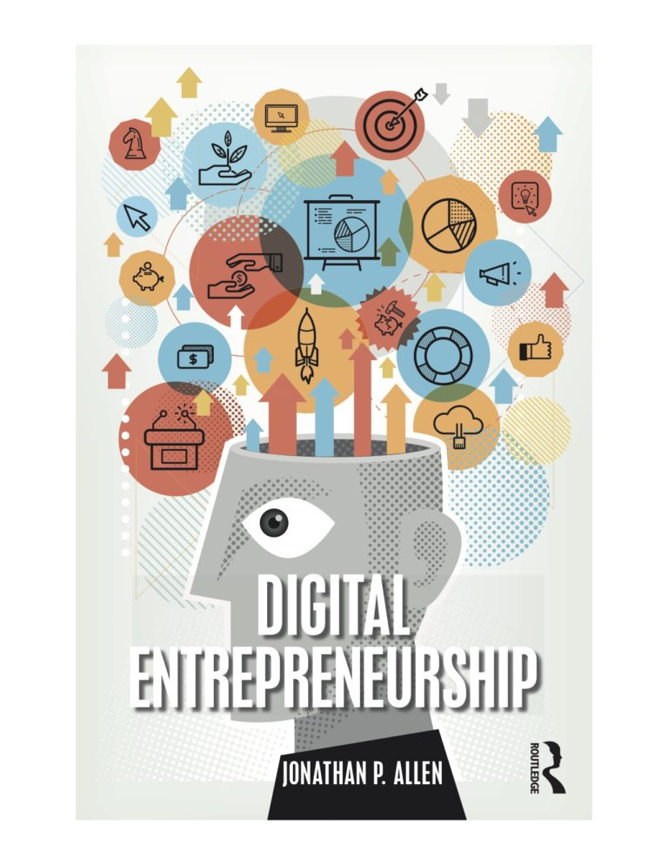
Chapter 11
Customer Acquisition in a Digital World
J.P. Allen version 4-15-19

Slide 2
Highlights and Key Takeaways
Attracting new customers online is becoming a vital skill for all businesses, digital or not.
Attracting customers in the digital world means competing with hundreds of millions of other web sites and apps.
The most important customer acquisition channels include search, social media, paid advertisements, and email marketing.
Search engines are a major source of potential customers online, with high conversion potential. Placement in the most relevant search rankings is critical, making search engine optimization an important activity.
Social media is a fast growing source of customers online. A social media customer acquisition strategy includes a content strategy, an engagement strategy, and an influencer strategy.
A digital business should have clear customer acquisition goals, with a specific numeric target for each channel.

Slide 3
The New World of Customer Acquisition
The full set of digital marketing options, from search engines to social media influencers, from real-time advertising bids to affiliate networks, has made new customer acquisition more complex, but has also created many opportunities for digital entrepreneurs.
One theme that distinguishes digital marketing is the richness of interactions that customers have not only with a business, but also with each other.
Digital entrepreneurs need to attract a sufficient number of high quality visitors.
The sufficient number is determined by the conversion equation in the current digital business design.
High quality visitors are the ones who are more likely to convert.

Slide 4
Product Purchase Information
Customers use digital information the majority of the time in their product research and purchase decisions.
82% of smartphone users consult their phones before making an in-store purchase.
82% of Americans consult online reviews before purchasing something for the first time.
86% of Americans want to compare prices or look for discounts online, and 84% want to be able to ask questions before a purchase.
Information from business websites, and online customer reviews, are some of the most trusted sources of product information, only ranked behind personal recommendations.
In Business-to-Business sales (B2B), the effects are even stronger—nearly 100% of business customers do online research before considering a purchase.

Slide 5
Search
For many digital businesses, search engines such as Google are the single largest source of visitors.
For big online retailers, unpaid or organic search results provide over a third of all visits on average, while paid advertising that appears next to search results provide another quarter of all visits.
By knowing the visitor’s query, or the phrase used in the search, it is often possible to guess the intent behind the search. Search intent makes it easier to serve a customer’s needs, and discover new, previously unserved needs.
The key thing about search from a customer acquisition standpoint is that it is largely a winner-take-all game.
The top search result averages a 30% click through rate, declining to 15% on average for the second position, 10% for third, and down to 5% by position number five. At the bottom of the first page of search results, by position number 9 or 10, the average click through rate is 2% or less.
The challenge is to find the search queries where it is possible to be a top search result, but that also generates enough traffic to test your prototype.

Slide 6
Becoming a Top Search Result
The first step is for a search engine to know that your site exists.
Google and other search engines have software that regularly downloads, or crawls, all of the web pages it knows about, and follows all the links it finds on every page.
Once a search engine knows about your web site, it indexes every page to associate it with a set of keywords and phrases that it finds on page.
Search result order is determined by the all-important ranking algorithm.
Google says that over 200 factors are considered in their rankings.
The algorithms are constantly changing, much of it in response to people trying to game the system and move their pages to the top of the rankings.
In search engine optimization, or SEO, experts try to reverse engineer the constantly changing, secret ranking algorithms and use any means possible to move pages up the search rankings at the expense of the competition.

Slide 7
Search Ranking Factors
The factors that affect search rankings can be divided roughly into internal and external SEO factors.
Internal factors have to do with the design of your web page, and are under your control.
For example, the exact search query, or something very close to it, should be included in prominent places on a page, such as in the page title, page headings, navigation links, or even within the URL.
External SEO factors are outside of your page design, and to a greater extent are outside of your control.
The main external factor is links from other pages, to your page.

Slide 8
Keyword Strategy
The first task in a keyword strategy is choosing the keyword, or keywords, to target.
Google Ads provides a keyword planning tool that gives vital information about each potential search phrase: how many searches per month, the level of competition, and the cost per click for an advertisement that appears next to search results.
Avoid queries with zero searches.
Once a keyword or keywords are chosen, steps can be taken to improve internal, or on-site, SEO, and external SEO, which happens off-site.
SEO reveals the level of performance necessary to beat the competition. To rank higher than another site on a search query, either the internal SEO has to be better, or external SEO, or both.

Slide 9
Exercise
Identify a keyword phrase as the target for your keyword strategy.
For this keyword phrase, identify the competitor URL you hope to surpass in the search rankings.
Evaluate the SEO reputation of this competitor site.

Slide 10
Implementing Internal SEO
The most important task for internal SEO is to make sure that the exact keywords and phrase being targeted is on the site, and in the right places. Make sure your keywords are featured in places such as:
Page title.
URL.
Prominent places on page, such as headers.
In HTML <meta> tags, which define information about a page such as keywords and a short description.
In the ‘alt’ attribute of HTML <img> tags for images.
It can also be helpful for the links within a site, such as the menus and navigation, to consistently point to a single page on site that is associated with a keyword or keyword phrase.
As ranking algorithms change, new internal SEO factors will rise or fall in importance.

Slide 11
Exercise
Identify three specific actions for implementing internal SEO on your prototype site.
Implement these actions.

Slide 12
Implementing External SEO
The best links are from other sites that are themselves highly ranked.
To win an external SEO competition, your prototype site needs to have comparable or better links than another competitor site.
First, link to your prototype site from other sites or profiles that you control.
Next, target other reputable sites that will include a link to yours.
There may be specialized news sites in your area of interest, or established bloggers who need content.
Discussion boards or online communities can be other places to naturally include links to your prototype, though some have restrictions on self-promotion.

Slide 13
Exercise
Find two other sites that are likely candidates for adding inbound links to your prototype site.
Check that these sites have sufficient reputation to implement your SEO strategy.
Describe the actions you would take to earn those inbound links.

Slide 14
Social Media
Social media is the fastest growing channel for bringing customers to retail sites, perhaps up to a third of all web traffic.
Social media is especially appropriate for more unique, personalized consumer products that tie to people’s identity or personal values.
Social media includes the big name platforms such as Facebook and Instagram, but also includes specialized platforms such as LinkedIn and Pinterest, content sites with community discussion such as YouTube and Reddit, and review and rating sites.
With marketing shifting to more conversational modes, rather than broadcasts, there are many potential marketing uses of social media.
Social media can help build brand awareness, find influencers and brand advocates, support customers, learn about customer needs, and shape public relations, in ways that newer companies can take advantage of.

Slide 15
Exercise
Create a business social media profile for your digital business.
Establish links in both directions between your social media profile, and your prototype site.

Slide 16
Customer Acquisition Content Issues
Issue | Search | Social Media
Discovery | Search queries; keyword phrases; changing search ranking algorithms | Hashtags; changing news feed ranking algorithms
Virality | Inbound links from high reputation sites | Network connections; influencers
Content Mix | Short vs. long form; images and video | Sales vs. education vs. entertainment
Timeline | Regularly updated original content | Posting frequency; time of day

Slide 17
Social Media Strategy
The content strategy defines the mix of commercial, educational, and entertainment content, as well as post frequency and timing.
Social media content is more effective when it is not just a stream of commercial messages. Content that connects emotionally, sparks conversations, raises questions, or make people feel good about themselves tend to have more reach on social media.
The engagement strategy is the plan for getting customers to follow a social media account, and then engage with its content by sharing, liking, and commenting.
Messages with high quality arguments, that attract more likes and comments, and that are considered admirable and appealing are more likely to be liked and shared.
The influencer strategy is the plan for quickly spreading content through a social media network.
Influencers are trusted almost as much as personal recommendations in terms of product endorsements, and fit better with how many social media users like to learn about new products and services.

Slide 18
Discussion Question
Describe the social media content strategy for your digital business.
What would be a reasonable target for number of visitors per month?

Slide 19
Exercise
Identify the actions you will take in the first week to implement the social media engagement and influencer strategy for your digital business.

Slide 20
Other Channels: Email
In email marketing, email addresses are collected from potential customers, who are then sent regular newsletters. Links in the newsletters bring visitors back to a prototype site.
Email marketing is simple, inexpensive, and has high conversion rates.
Typically, an outside service is used for email marketing.
Specialized services know how to get around the spam filters which stop around 90% of all emails. Outside services can track how often mailboxes are opened in inboxes, manage subscriptions, and send higher volumes of mail more quickly than the email servers available on a shared hosting service.
Using links with custom URLs, or unique landing pages, allows the effectiveness of each newsletter to be tracked in web analytics.
Newsletter content can either be treated more like a direct mail sales exercise, or as another type of social media with a mix of commercial, educational, and entertainment content.
The social media approach provides general information, tips, and customer stories, along with sales pitches and calls to action.
A pure direct mail approach will try to create a click by using ‘bait’ to capture attention, an argument why a product or service can solve a problem, and an immediate call to action, the standard persuasion tools of direct mail.
In a direct mail approach, the text would also try to motivate customer action by generating emotional responses such as fear, followed by guilt, greed (discounts and low price), and exclusivity.

Slide 21
Other Channels: Paid Advertising
Most customer acquisition channels—search, social media, and email—take time to build. Paid advertising is an effective tool for generating customer visits quickly.
Advertising campaigns can be set with either manual cost-per-click bids, or by specifying a ranking and letting the cost adjust automatically.
Remarketing can be used customize advertisements based on previous visits.
Google has one of the largest advertising networks, but there are many other network for publishing advertisements on web sites.
Video ads are only about 10% the revenue of television advertising, at around $5 billion a year, but are growing quickly.
Social media ads have the advantage of precise targeting based on detailed demographics and interests.
Social media ads offer the choice of traditional display advertisements on the side, or promoted or ‘boosted’ content inside the news feed itself.
Social media ads sometimes have to work a little harder to capture attention, and to induce action away from the platform.
Affiliate marketing pays a referral fee for each successful conversion.

Slide 22
Other Channels: Word of Mouth
Word of mouth marketing through online reviews, in-person events, and old fashioned publicity can be a powerful source of customers, even for a digital business.
Every digital business should be soliciting reviews and testimonials from day one.
Entrepreneurs usually being word of mouth marketing with their own networks, and expand upon them using classic guerrilla marketing techniques such as free events, seminars, product demonstrations, and free consultations.
The impacts of word of mouth depend on how their language is perceived.
Word of mouth takes more time and energy than money, which is a positive feature in the earliest phases of a business test, but can be challenging to scale up much beyond the personal network.
Try to use word of mouth not only as a customer acquisition channel itself, but to build reputation and a following in other channels that will generate new visitors more consistently.

Slide 23
Other Channels: E-Commerce Platforms
For digital businesses that depend on sales, placement on e-commerce platforms can drive visitor traffic.
A platform like Amazon Marketplace will charge a 6-15% referral fee for each sale, plus a monthly subscription fee.
Warehousing and fulfillment services are available for additional charges.
On e-commerce platforms, a massive audience comes with cutthroat competition.
A Shopify, Etsy, or eBay store can attract additional customers, as well as provide useful storefront, payment, and fulfillment features.

Slide 24
Discussion Question
Choose at least one customer acquisition channel from this lesson, and discuss why this customer acquisition channel might be more appropriate for your digital business prototype than either search or social media.

Slide 25
Setting Customer Acquisition Goals
Many companies now try to improve customer acquisition across multiple channels, or multichannel.
Acquisition and conversion activities are often more effective when messages, and calls to action, are seen across multiple channels.
With additional tracking code, and the use of custom URLs, multichannel conversions can be tracked in web analytics.
From the perspective of testing a new digital business design, the important deliverable is a numeric target for each of the most important channels.
How many visitors per month will each channel deliver to the prototype site?
These targets, added together, are the first part of the conversion equation which, combined with conversion rate, will determine the success of the prototype.

Slide 26
Exercise
What is the overall customer acquisition goal for your digital business prototype, in terms of unique monthly visitors?
How many visitors will search and social media each contribute toward this goal?

Slide 27
Additional Links
www.google.com/webmasters/tools/home—Google Search Console, for submitting site URLs for crawling.
adwords.google.com—Google advertising platform with keyword planner tool.
www.wordtracker.com—keyword idea search tool.
moz.com/learn/seo/what-are-keywords—background on search keywords.
moz.com/free-seo-tools—tools for keyword ideas and external SEO research.
www.w3schools.com/tags/tag_meta.asp—additional HTML tags for internal SEO.
www.w3schools.com/tags/att_img_alt.asp—HTML tag attribute for adding keywords to images.
moz.com/learn/seo/domain-authority—background on how sites build reputation in search results.
mailchimp.com/pricing/free/—example of an email marketing service with a free service level.

Slide 28
Supplemental materials for the book:
Digital Entrepreneurship,1st Edition
by Jonathan P. Allen
Published by Routledge, 2019.
Routledge website
Book website with additional materials and ideas

